Slide 1



nutrisynccollective.com
contact@nutrisynccollective.com
NUTRISYNC
HORMONAL CARE MADE EASY
Pilar Gonzalez
Lucia Cebrian
Maria Paula Garzon

Slide 2




Building Scalable Women’s Health Infrastructure
Preventative & personalized nutrition aligned
with hormones
Symptom tracking & optimization engine
Advancing digital infrastructure for an underfunded healthcare segment
Closing the women’s health data gap through real world data
NUTRISYNC
Notes:
Closing the women’s health data gap through realworld cycle data
Increasing menstrual health literacy
Advancing digital infrastructure for an underfunded healthcare segment
mpact Metrics Embedded in Product
% reduction in self-reported PMS symptoms
Improvement in cycle literacy score
30-day retention as value proxy
NPS & behavioral adherence rate

Slide 3
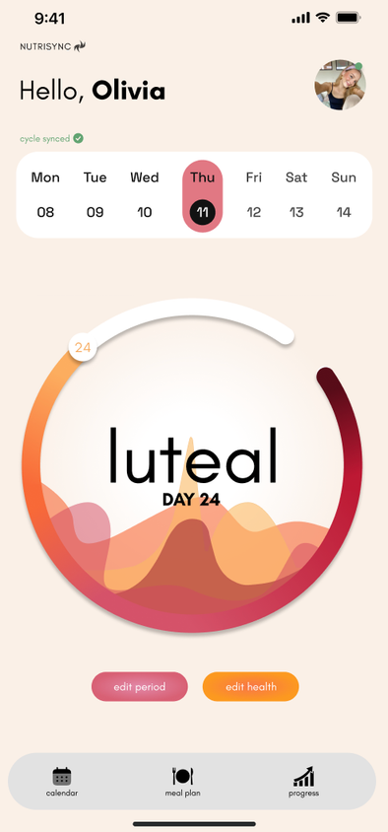
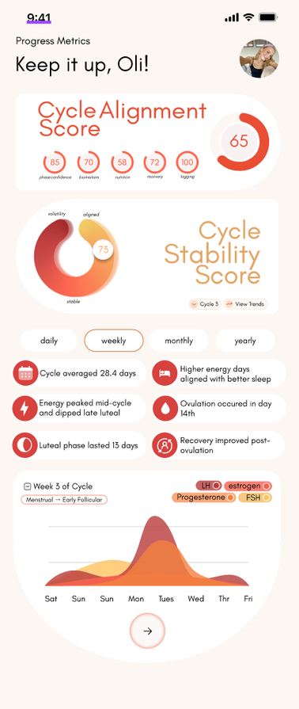


NutriSync The Adaptive Cycle Intelligence
Our Value Proposition
NutriSync transforms user’s cycle data into actionable personalized guidance that adapts in real time to user’s biology and lifestyle
The NutriSync Difference
Shows user’s how they are improving according to their own baseline and adapts to them
  Cycle Alignment Score
  Cycle Stability Score
  Personalized Adaption
  Science Backed Intelligence
  Holistic Optimization
  Privacy by Design
NUTRISYNC
Notes:
EASY
RE-IMAGINED FUTURE FOR WOMENS HEALTH.
INNOVATION
DRASTIC CHANGE
NEW WAY OF LIFE.
SCIENTIFIC FACT

Slide 4
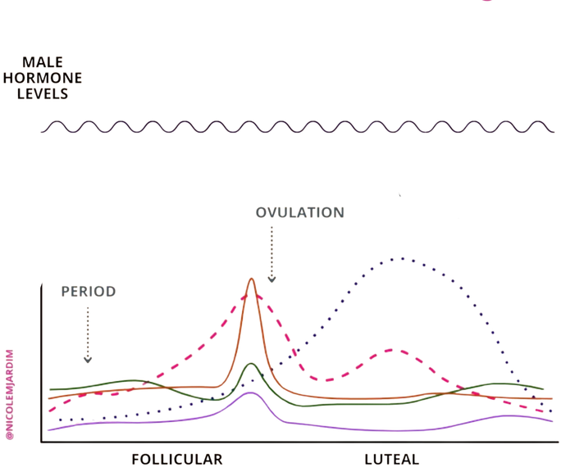
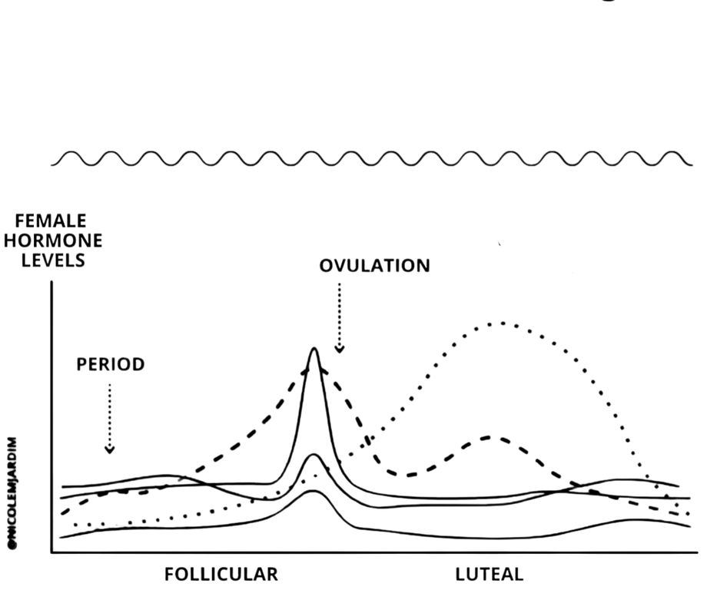

Different Biology Same Nutrition.
Most nutrition plans were built for men, leaving women’s 28-day cycles overlooked.
The ‘one size fits all diet’...
Does not take this into account.
Male Hormones 28 days
Female Hormones 28 days
(Source: FemTech Analytics, 2023)
NUTRISYNC

Slide 5
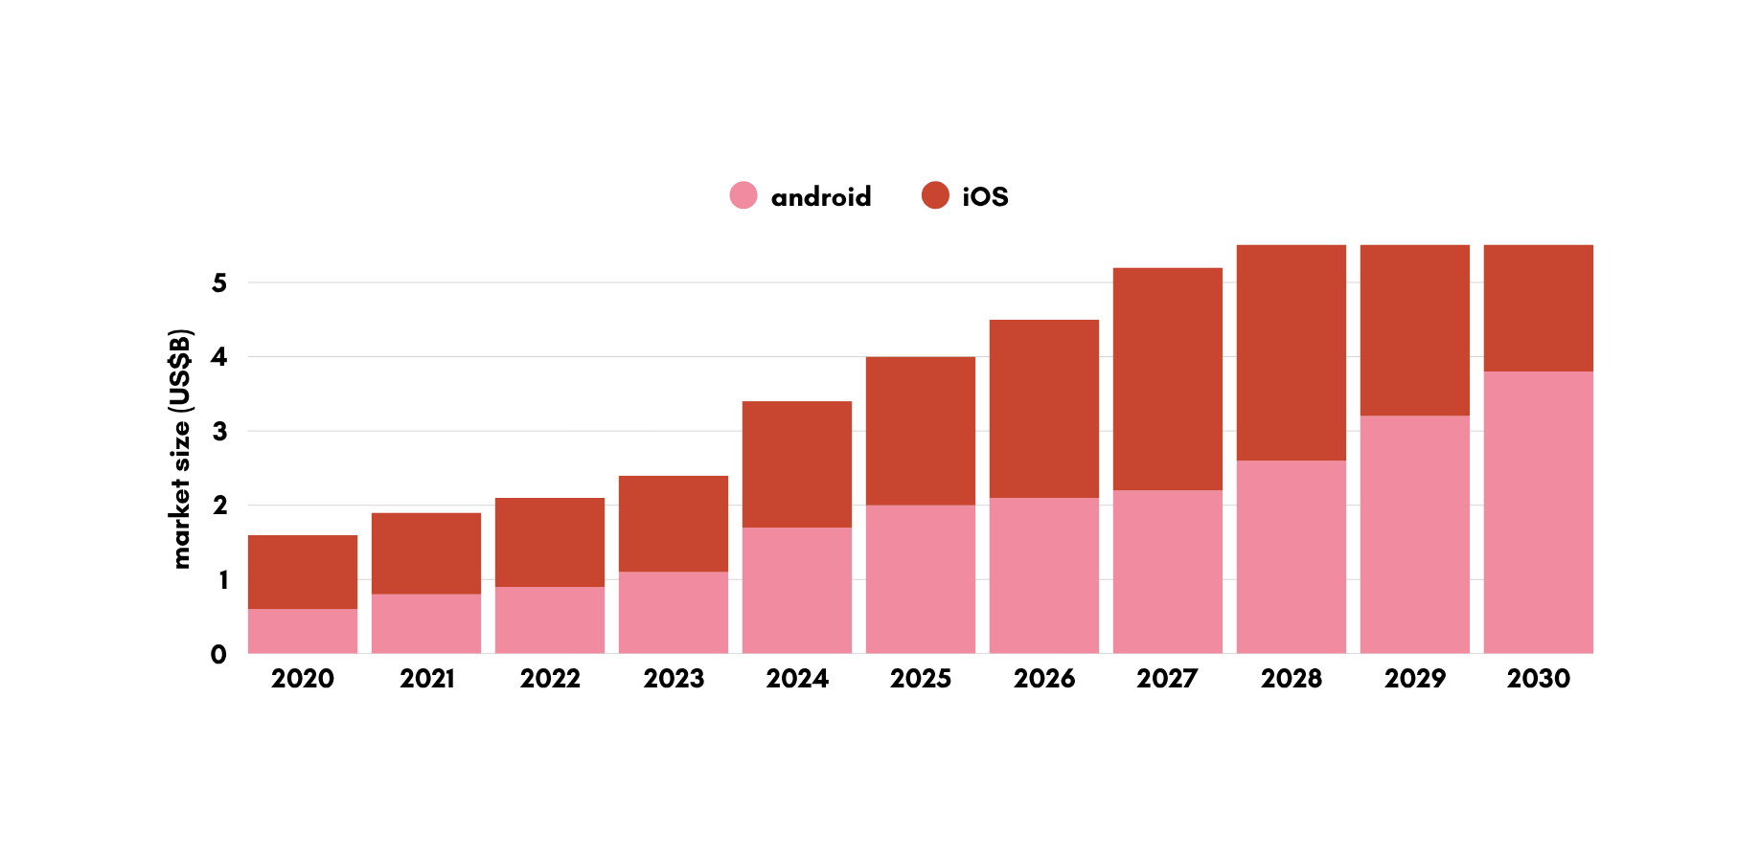
Menstrual Health Apps Market
CAGR: 20.24%
By 2030: $5.07Bn
Sources: (Grand View Reaserch, 2020-2030)
NUTRISYNC

Slide 6
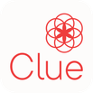


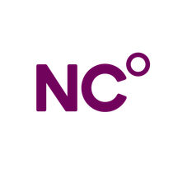




The NutriSync Difference
GENERIC APPS
ADDITIONAL CONTENT
NUTRISYNC
SCIENTIFIC &
CLINICAL BASE
SCIENCE-BACKED CYCLE-SYNC FRAMEWORK
ETHICAL DATA & PRIVACY DESIGN
INTEGRATED CYCLE, NUTRITION & FITNESS PLANS
AI PERSONALIZATION
-
PRODUCT &
AI LAYER
SOCIAL & COMMUNITY FEATURES
DIRECT-TO-CONSUMER
-
-
KEY
DISTRIBUTION &
DATA FLYWHEEL
-
-
-
BRANDS NEED TO SOLVE SEPERATELY
INSTITUTIONAL ATL OUTREACH
TTL DATA & INSIGHT LOOP
PARTIAL
-
-
CORE CAPABILITY
NUTRISYNC
Notes:
replace with icons so less words

Slide 7
Spanish Market
€1.4Bn
Spain’s women’s health app + corporate wellness
All Spanish companies and women who could ever pay
€168M
Women paying for digital health + B2B wellness buyers
2M Spanish women already paying and companies actively purchasing digital employee wellness
€1.2M
Spain share of projected 400k users
Sources: (INE, 2024), (Heraldo, 2023), (Agencia SINC, 2023), (European Psychiatry, 2022)
NUTRISYNC

Slide 8



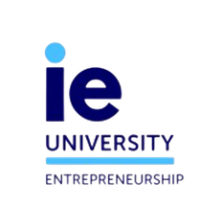

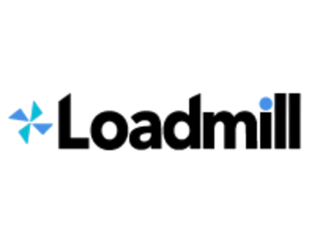
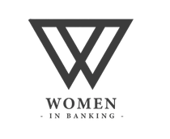
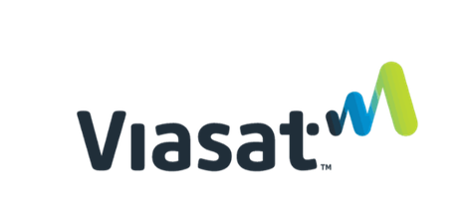
Traction
On track to launch to 200 users in Q3 2026
Customer Validation
Early Revenue
Demand
160 Interviews
  €420~ from Paid Events
  32~ Total Paying Attendees
  150 Women Waitlist
  30k Organic Views
  University + Corporate Partnerships
  30 women piloting wave 1
  96% report cycle impacts performance
  86% want a personalised solution
RUNNER-UP – IE VENTURE LAB (200+ STARTUPS)
2ND PLACE – IE ENTREPRENEURSHIP SUMMIT (60 STARTUPS))
2ND PLACE - ESADE SHARK TANK (100+ STARTUPS)
NUTRISYNC
Notes:
make visuals better

Slide 9
Business Model
Four revenue streams. Subscription first, B2B as the multiplier, clinical partnerships as the moat
B2C BASIC
B2C PREMIUM
€4.99/mo
€12.99/mo
Core subscription. Cycle aware nutrition + fitness plans. Penetration pricing to maximise Y1 user volume
Launches month 13. AI personalised cycle plans + clinical consultation booking. 160% more revenue per user
B2B CORPORATE WELLBEING
CLINICAL + EVENTS + BRAND
B2B CORPORATE WELLBEING
€3.99/mo
€500-8K/source
€3.99/mo
Corporate wellness contracts. Warm leads active. Avg 150 employees = €5,985/yr per contract. Renews at €5.99.
Clinic referral fees, paid workshops/masterclasses, and founder brand partnerships as social audience scales
13.6x
2.85x
€4.20
€20
88%
1mo
4.7mo
LTV:CAC
ORGANIC
LTV:CAC
CAC
ORGANIC
CAC
GROSS
MARGIN Y3
PAYBACK
PERIOD ORGANIC
PAYBACK
PERIOD
NUTRISYNC

Slide 10
From Waitlist to Global Platform
M1-12 LAUNCH & FIRST DATA
M13-24 ACTIVE DEEP TECH
M25-36 HORMONAL HEALTH
⟶ Testflight & Playstore launch
⟶ CTO hired, first €4.99 subscriptions live
⟶ Apple HealthKit (M2)
⟶ AI personalisation engine
⟶ 2 clinical partners signed, B2B pilot
⟶ GDPR health data architecture
Target: 3.5K+ users €20K MRR
⟶ Conversational AI companion
⟶ Premium tier live €12.99 live
⟶ Predictive hormonal modelling
⟶ UK + Australia + Portugual
⟶ 10 B2B, 5 clinical partners
⟶ Perimenopause tracking
Target: 20K+ users €80k MRR
⟶ CGM integration
⟶ At home hormone test kit integration
⟶ Menopause as dedicated product tier
⟶ US launch, AI model matures
⟶ Academic publication of clinical findings
Target: 80K+ users €200k MRR
FOUNDER SOCIAL
PAID SOCIAL M4+
B2B & CLINICAL
EVENTS & COMMUNITY
Founders posting on Linkedin, Instagram, Tiktok. Target demograhic audience, Zero marginal CAC
€3-5k/mo on Instagram & Tiktok from month 4. CAC €6-8 (50% below industry average)
One 150 employee contract = 150 users instantly. Clinic referrals: 50 patient conversions/clinic/mo
Paid events already generating revenue. Attendees convert to subscribers at 40-60% rate
4K followers today ⟶ 50K+ Y3
375-625 new users/month
5 contracts = 750 B2B users Y1
2 events run ⟶ €500-1k/event
NUTRISYNC
Notes:
make it go higher

Slide 11
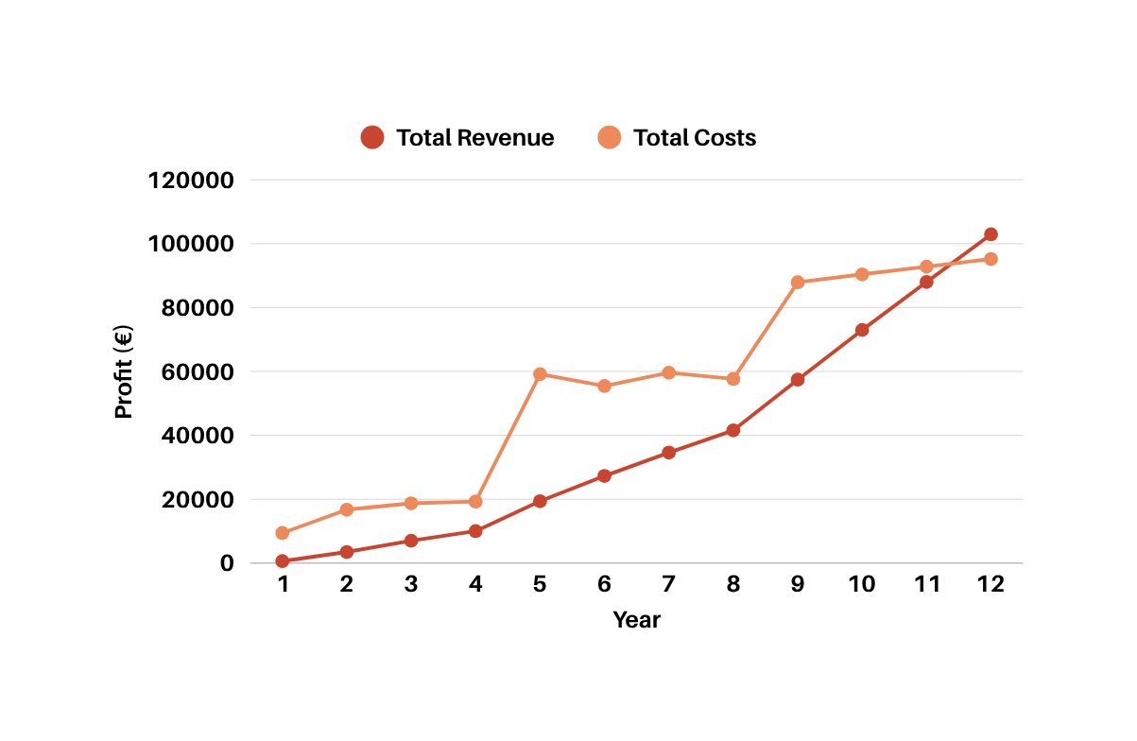
Capital Efficient Growth
€902K
NutriSync Projections - Conservative (quarterly)
Y3 Annual revenue
120
ARR: €1.04M annualised
,
,
100
Breakeven
,
,
15.5K+
80
,
,
€(Thousands)
60
Year 3 paying users
Deep tech Y2+ impact
,
,
40
M35
20
,
,
QUARTERS
Reach profitability
USER
GROWTH
>1K
+1.8K
+6K
+15.5K
NUTRISYNC

Slide 12





Join Our Growth Journey
350k
Tech infrastructure
34%
€119K
RAISING
Team stipends
26%
€91K
Marketing & paid social
20%
€70K
Clinical partnerships
12%
€42K
18-month runway
Legal, ops & admin
8%
€28K
MONTH 1
MONTH 9
MONTH 13
App live & first revenue
4000+
paying
users
Seed
Round
Closes
NUTRISYNC
Notes:
“We are raising €250K pre-seed to validate our engine, clinical backbone, and early user behaviour. This sets us up for a strong Seed round once traction is proven.”
ASK KANIKA FOR PRE-SEED
GROWTH AND FUNDRISING

Slide 13
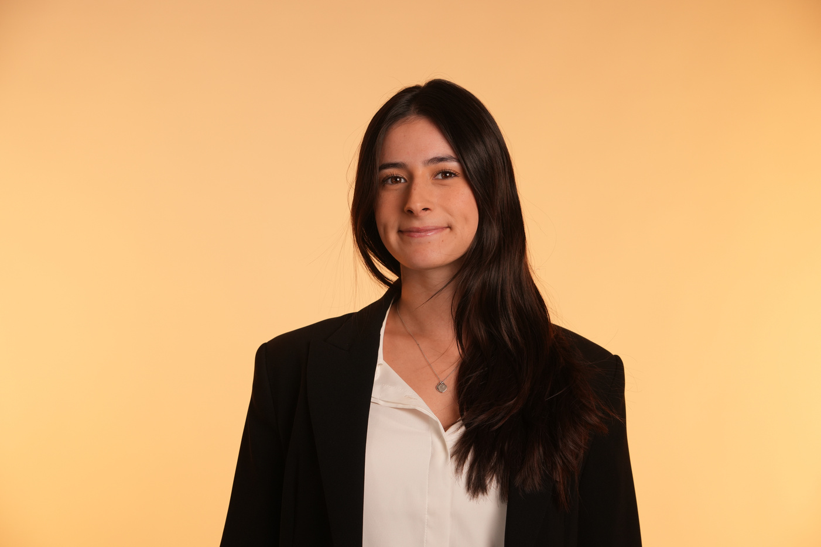

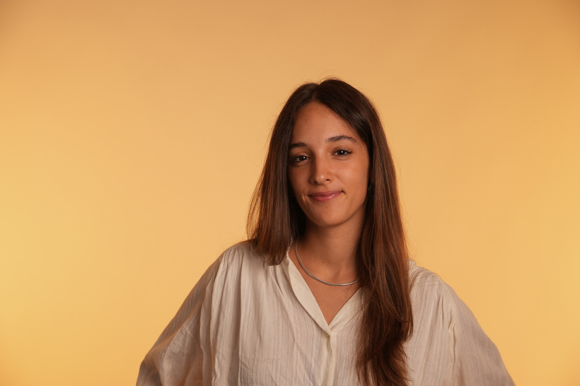
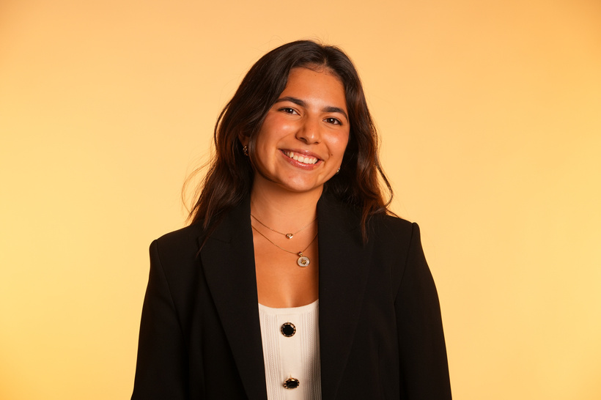
Pilar Gonzalez
Lucia Cebrian
Maria Paula Garzon
CEO - Co Founder
Experienced in strategy
COO - Co Founder
Experienced in UX/UI design
CMO - Co Founder
Experienced in branding
Your Vision
NUTRISYNC

Slide 14
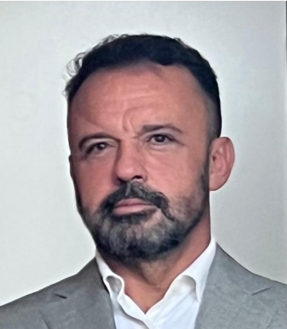
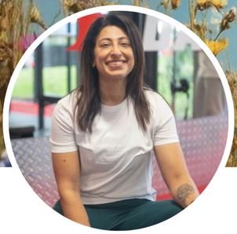

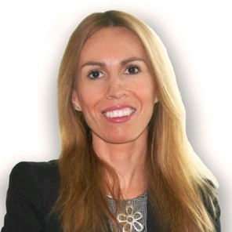
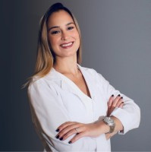
Advisory Board
Juan Jose Gonzalez
Technology & Digital Transformation
  CTO of CHUBB
  Supports NutriSync’s digital infrastructure, product scalability, and AI-driven user experience strategy.
Kanika Pandey
AI & Growth Strategy
Clara Miranda
Strategy & Brand Innovation
  CRO of Global Sales at Loadmill with deep expertise in scaling high-growth tech companies.
  Advises NutriSync on growth strategy to accelerate scalable expansion.
  Former Global Innovation Lead at ING.
  Advises on strategic roadmap development and market positioning to strengthen NutriSync’s competitive advantage.
Beatriz Serrano Sordo
Finance & Governance
Constanza Ramirez Milli
Clinical Nutrition
  Nutritionist specialized in clinical nutrition & corporate wellness.
  Ensures NutriSync’s nutritional approach is science-based.
  Senior Credit Analyst at AXA.
  Provides financial oversight, funding strategy, and corporate governance guidance.
NUTRISYNC

Slide 15

nutrisynccollective.com
contact@nutrisynccollective.com
NUTRISYNC
HORMONAL CARE MADE EASY

Slide 16
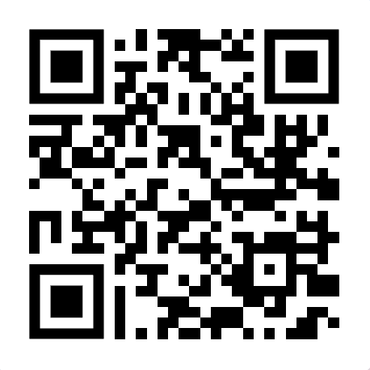
nutrisynccollective.com
contact@nutrisynccollective.com

Slide 17
Deep Tech Rollout
Four deep tech layers sequenced by funding stage
1.
3.
ADAPTIVE AI
PERSONALIZATION ENGINE
(now-M6)
CONVERSATIONAL AI NUTRI
COMPANION
(M13 Premium)
PREDICTIVE HORMONAL MODELLING
LAB TEST + CGM INTEGRATION
(series A Y3)
DATA MOAT
CLINICAL MOAT
DISTRIBUTION MOAT
Every user who tracks 3+ months creates a unique hormonal data signature. Competitors cannot buy this dataset, they would need 5 years to build.
Clinical partnerships take 12-18 months to build. We start now. A generic wellness app cannot replicate co branded clinical content in 6 months.
Founder social channels are the acquisition engine. 50K+ combined audience in exact target demographic. CAC advantage no competitor can replicate without the same founders
NUTRISYNC

Slide 18
Wearables Strategy
Turning an Apple Watch into a hormonal health advisor costs €0 in hardware and gives us access to 100M+ existing devices
1.
3.
APPLE WATCH + HEALTHKIT (M4)
GOOGLE FIT + WEAR OS (M4)
OURA RING (M15)
CGM - DEXCOM / ABBOTT LIBRE
(Y3)
(Y3)
Data: Heart rate, HRV, sleep stages, activity, skin temperature, blood oxygen
Data: Heart rate, activity, sleep, stress score
Data: Skin temperature trend, HRV, readiness score, sleep stages, resting heart rate
Data: Blood glucose fluctuates across cycle, causing energy crashes and cravings
Essential for Spain and Australia where Android market share is 70% +. Built in parallel with HealthKit, shared codebase, low marginal cost.
60% of our target demographic (urban women 25-45) owns an Apple watch.
HealthKit API free, 4-6 weeks dev time.
Most clinically relevant wearable for NutriSync. Skin temp data makes cycle prediction automatic. Oura has an investment arm and actively partners with health apps.
Glucose + cycle data = the most complete hormonal nutrition picture. Requires medical device partnership agreements. Series A territory.
50%
12.4x
€8K
FREE
Churn reduction for wearable connected users
LTV:CAC for wearable users
Total HealthKit dev cost payback <2 months from retained users
HealthKit, Oura Cloud, Google Fit APIs are all free for developers
NUTRISYNC

Slide 19
Long-term Expansion
An even bigger and almost empty opportunity
1.
3.
PERIMENOPAUSE TRACKING
HRT INTERACTION GUIDANCE LAYER
MENOPAUSE AS DEDICTATED PRODUCT TIER
MENOPAUSE B2B - WORKPLACE PROGRAMME
(soft launch M18)
(M22)
(Y3)
(Y3)
MENOPAUSE MARKET
$22.7B
1M+
~12
Global menopause market by 2028, 7% CAGR
Women entering menopause per year in the US alone
App solutions available, mostly symptom trackers
  Same infrastructure - different life stage
  Higher ARPU than core product
  Proven market demand, almost no tech supply
NUTRISYNC

Slide 20
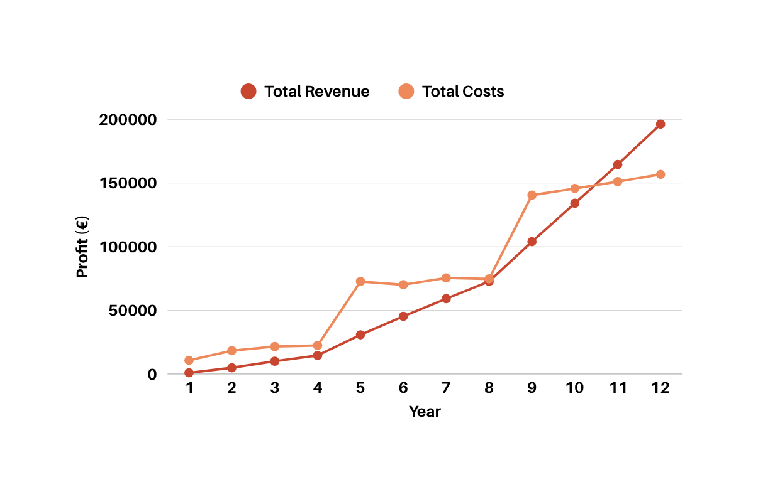
Capital Efficient Growth
€1.67M
NutriSync Projections - Realistic (quarterly)
Y3 Annual revenue
120
ARR: €2M annualised
,
,
100
Breakeven
,
,
30.3K+
80
,
,
€(Thousands)
60
Year 3 paying users
Deep tech Y2+ impact
,
,
40
M32
20
,
,
QUARTERS
Reach profitability
USER
GROWTH
>1K
+2.6K
+11.3K
+30.3K
NUTRISYNC

Slide 21
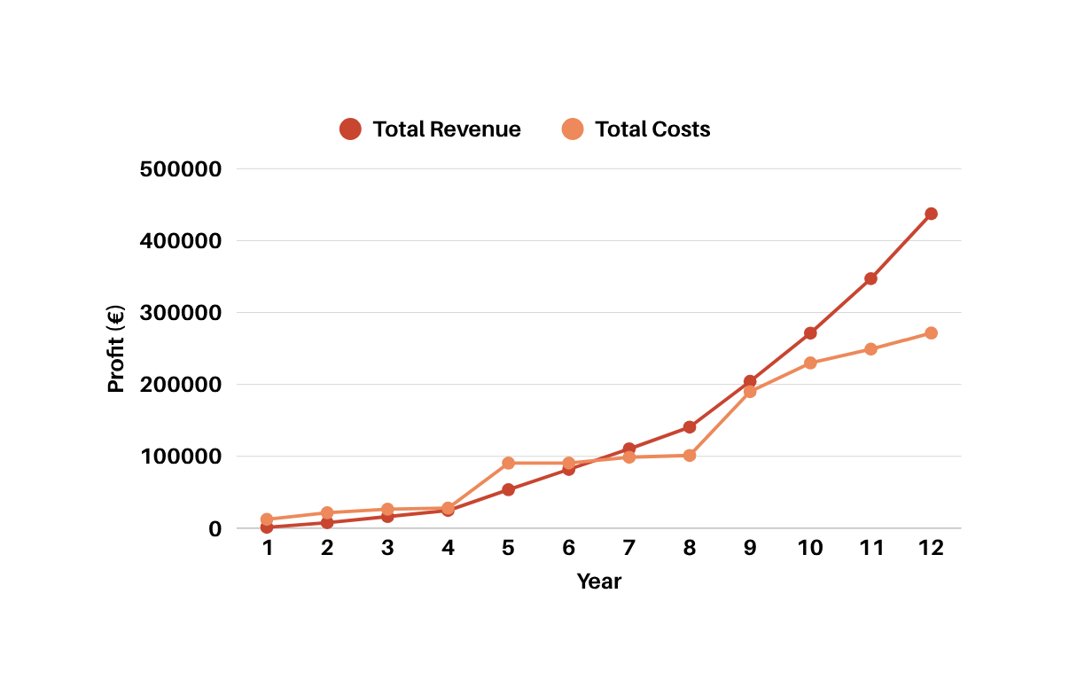
Capital Efficient Growth
€3.47M
NutriSync Projections - Ambitious (quarterly)
Y3 Annual revenue
120
ARR: €4.7M annualised
,
,
100
Breakeven
,
,
69.5K+
80
,
,
€(Thousands)
60
Year 3 paying users
Deep tech Y2+ impact
,
,
40
M27
20
,
,
QUARTERS
Reach profitability
USER
GROWTH
>1K
+4.4K
+22.2K
+69.5K
NUTRISYNC

Slide 22
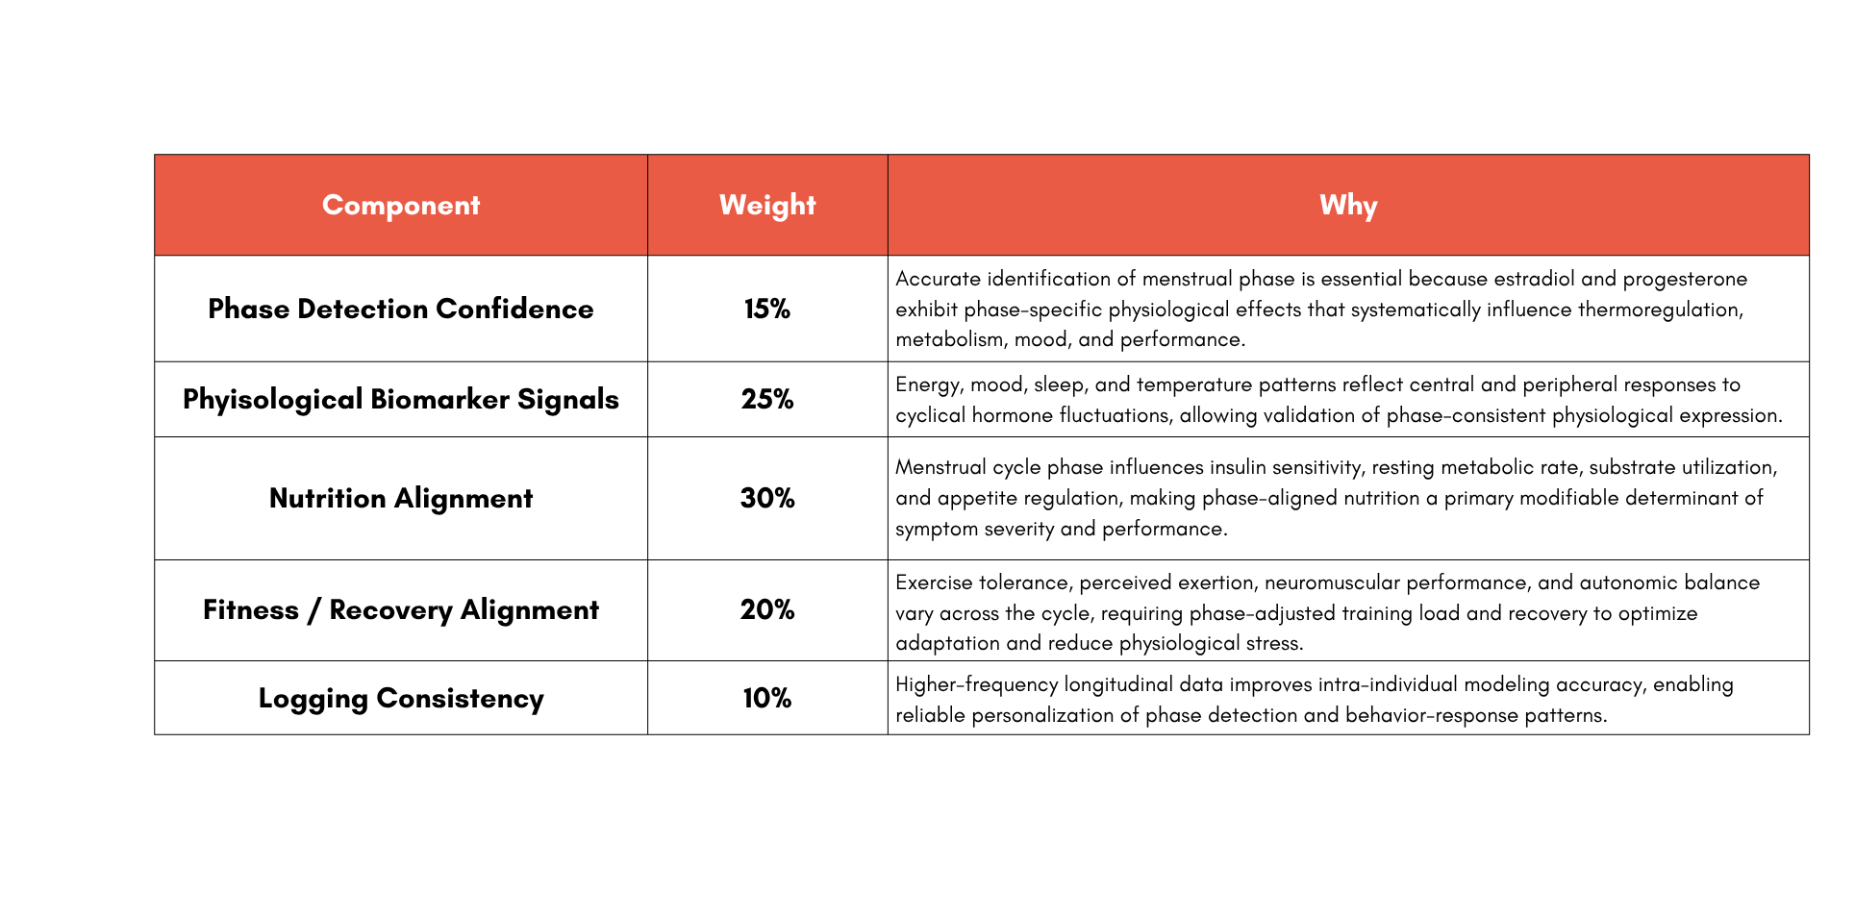
NutriSync’s Adaptive Cycle Intelligence
After 3 cycles algorithm must map symptom intensity per phase, identify user’s high sensitivity window, create a personalized symptom plan.
NUTRISYNC

Slide 23
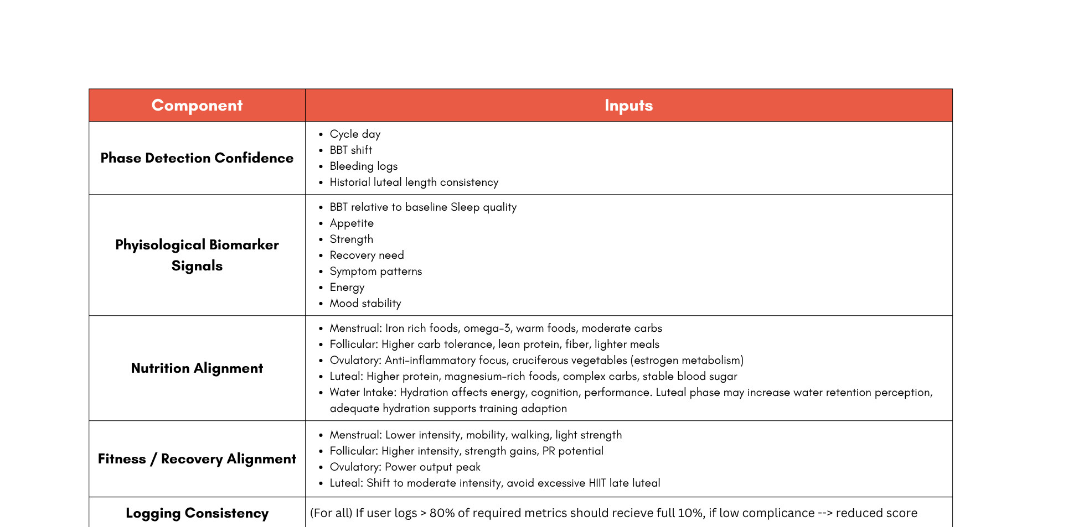
NutriSync’s Adaptive Cycle Intelligence
NUTRISYNC

Slide 24
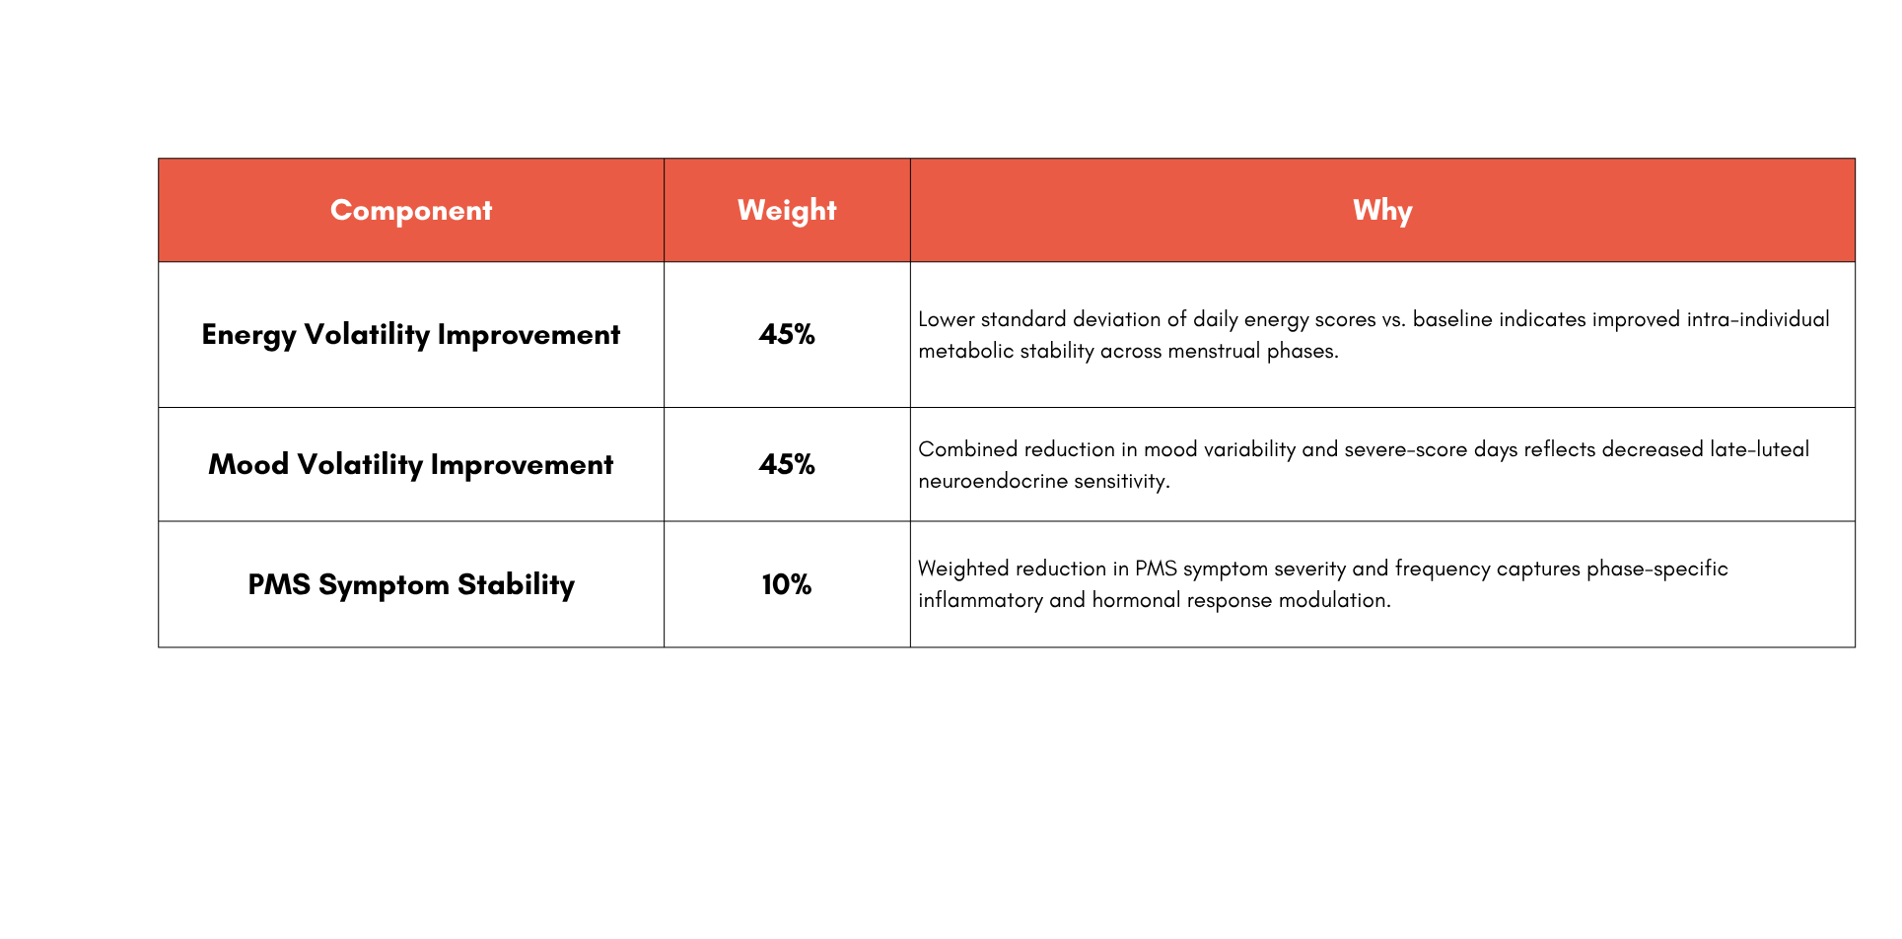
NutriSync’s Adaptive Cycle Intelligence
Measures longitudinal improvement vs. personal baseline using volatility and severity reduction across cycles.
NUTRISYNC

